Slide 1
BOOSTING ALGORITHMS
AdaBoost Regressor
Gradient Boosting Regressor(XgBoost)
LightGBM (Light Gradient Boosting Machine)

Slide 2
AdaBoostRegressor
AdaBoost stands for Adaptive Boosting. It is an ensemble machine learning algorithm that combines multiple weak models (usually small decision trees) to create a strong model.
The main idea is:
Adaboost focuses more on the data points that the previous model predicted incorrectly.
Important parameters:
n_estimators – Number of weak learners
learning_rate – controls how much each weak learner contributes.
random_state – Makes the result reproducible

Slide 3
How AdaBoost works
Suppose we have 10 training data points.
Step 1: Give equal weights
Initially, every data point gets the same importance/weight.
Step 2: Train the first weak learner
Usually, a small Decision Tree (Decision Stump) is used.
The model makes predictions.
Step 3: Find the wrong predictions
AdaBoost identifies which data points were classified incorrectly.
Step 4: Increase the weight of wrong predictions
The incorrectly predicted points are given higher weights.
Correctly predicted points get relatively lower importance.
Step 5: Train the next weak learner
The next model focuses more on the difficult/misclassified data points.
Step 6: Repeat
This process continues for several weak learners.
Step 7: Combine all models
Finally, all the weak learners are combined using their individual importance (model weight).
The stronger learners have more influence on the final prediction.

Slide 4
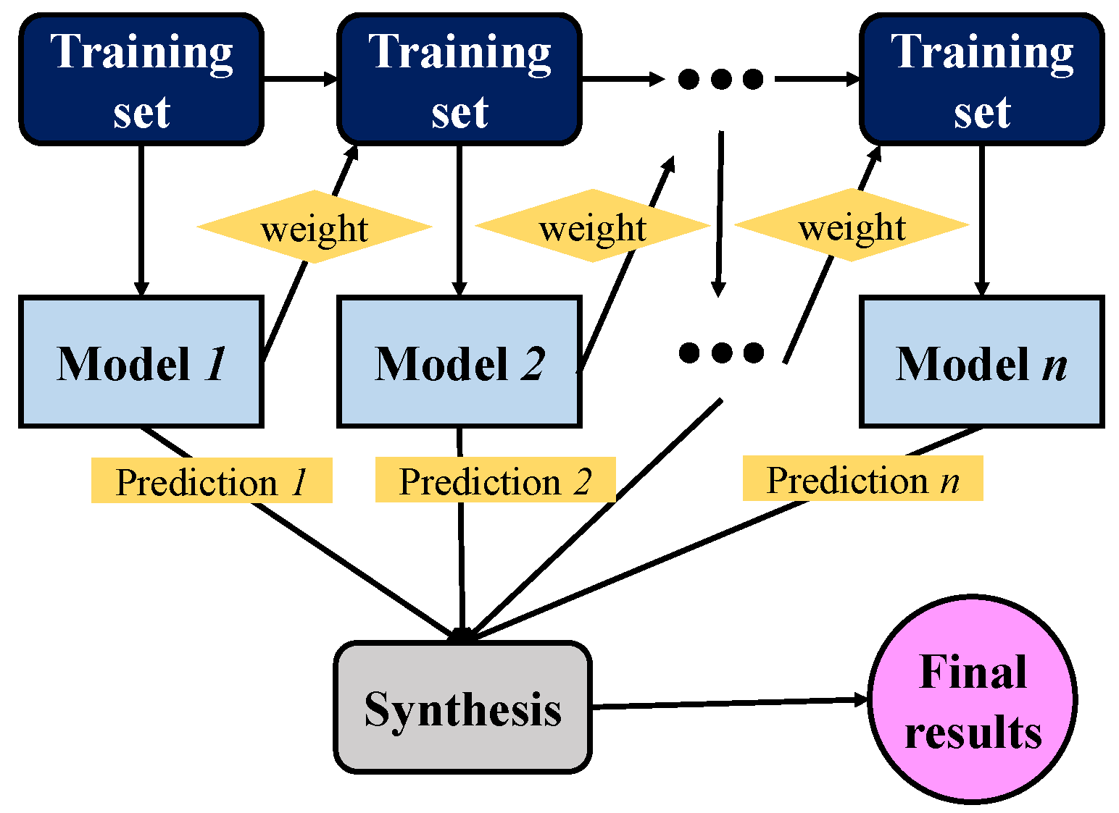
AdaBoost Algorithm

Slide 5
Advantages & Disadvantages
Advantages:
✓ Simple and easy to understand
✓ Often gives strong prediction performance
✓ Reduces bias by combining weak learners
Disadvantages:
✗ Sensitive to noisy data and outliers
✗ Can be affected by incorrectly labeled data
✗ Training is sequential, so it may be slower

Slide 6
XgBoost Algorithm
XGBoost stands for Extreme Gradient Boosting. It is an ensemble machine learning algorithm based on Gradient Boosting.
It combines many decision trees to create one strong predictive model.
Important Parameters:
n_estimators → Number of boosting trees
learning_rate → Controls each tree's contribution
max_depth → Maximum depth of each tree
subsample → Fraction of training data used per tree

Slide 7
How XGBoost Works
Suppose we want to predict house prices.
Step1: Make an initial prediction
The model starts with a simple prediction.
Step2: Build the first decision tree
The first tree makes predictions based on the available features such as:
Area
Number of bedrooms
Location
Age of house
Step3: Calculate the errors
Xgboost looks at the difference between the actual value and predicted value.
Step4: Build another tree
The next tree focuses on reducing the errors made by the previous model.
Step5: Repeat
XGBoost keeps adding trees. Each new tree tries to improve the overall model by reducing the loss function.

Slide 8
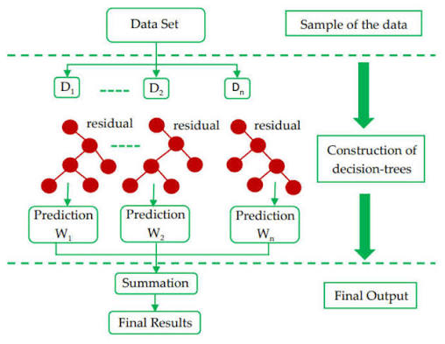
XgBoost Algorithm

Slide 9
Advantages & Disadvantages
Advantages:
✓ High prediction accuracy
✓ Works for classification and regression
✓ Handles missing values and many features
✓ Uses regularization to help reduce overfitting
Disadvantages:
✗ Requires parameter tuning
✗ Can overfit if not configured properly
✗ More complex than simple ML models

Slide 10
LightGBM (Light Gradient Boosting Machine)
LightGBM is an ensemble machine learning algorithm developed by Microsoft. It builds multiple decision trees sequentially, where each new tree tries to reduce the errors made by the previous trees.
It is especially effective for large and high-dimensional datasets.
Important Parameters:
n_estimators → Number of boosting trees
learning_rate → Contribution of each tree
num_leaves → Controls tree complexity
max_depth → Limits tree depth

Slide 11
How it works
Suppose we want to predict house prices.
Step1: Make an initial prediction
The model starts with a simple prediction.
Step2: Build the first decision tree
The first tree makes predictions based on the available features such as:
Area
Number of bedrooms
Location
Age of house
Step3: Learn from the error
LightGBM calculates the error and builds the next tree to improve the prediction.
There are two important techniques:
LightGBM grows trees leaf-wise and uses histogram-based learning for efficiency.

Slide 12
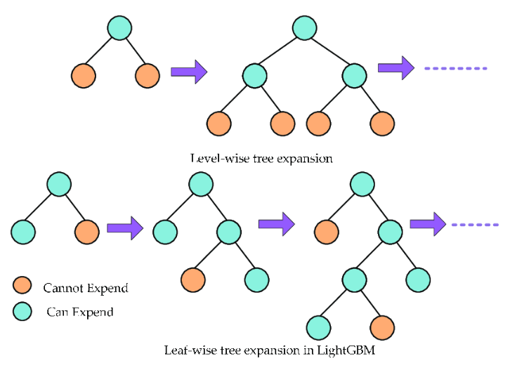
LGBoost Algorithm

Slide 13
Advantages & Disadvantages
Advantages:
✓ Very fast training and prediction
✓ Uses memory efficiently
✓ Works well with large datasets and many features
✓ Good accuracy for classification and regression
Disadvantages:
✗ Can overfit, especially on small datasets
✗ Requires parameter tuning
✗ Leaf-wise growth can create complex trees

Slide 14
Thank You

